Slide 1
Fraud Analytics

Slide 2
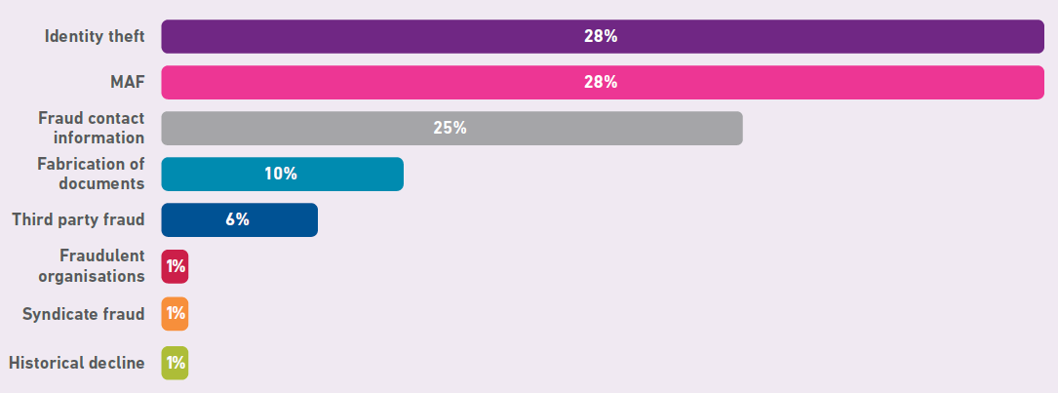
Distribution of different types of Frauds
Notes:
Experian Fraud Report 2018-19

Slide 3
Distribution of Frauds – by Product

Slide 4
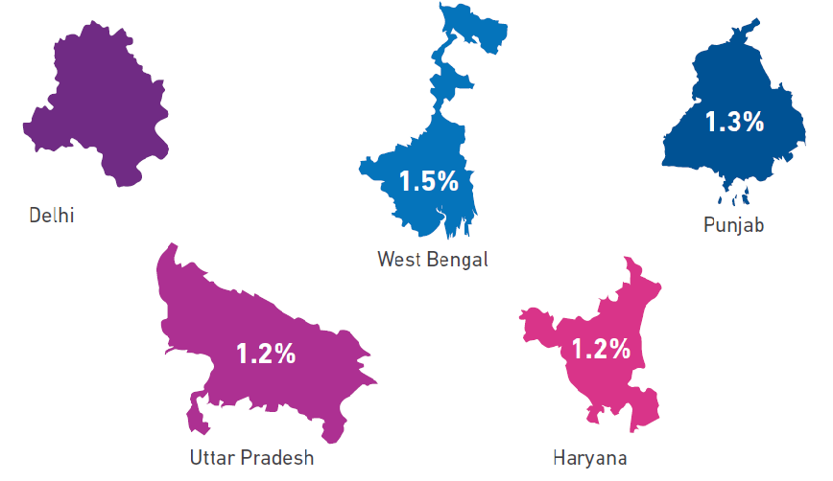
State-wise Distribution (major states)

Slide 5
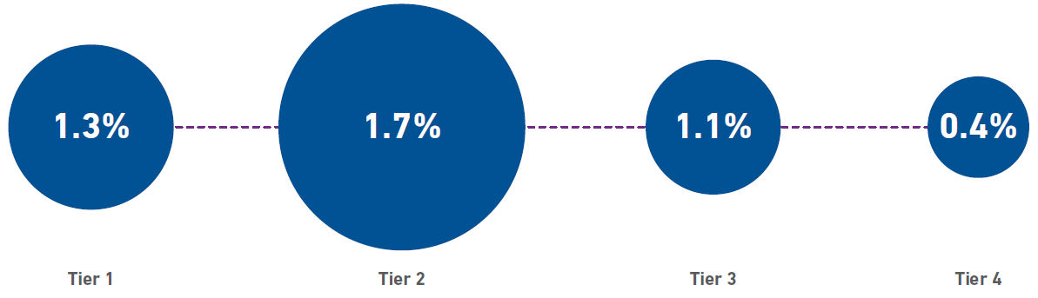
City-wise (tiers)

Slide 6
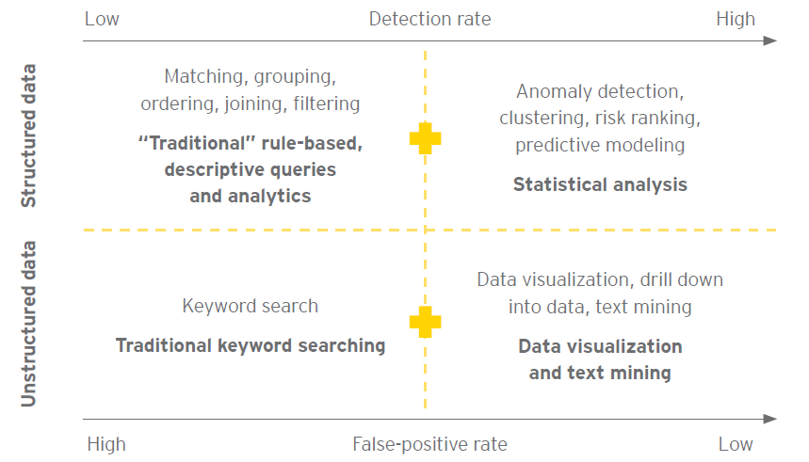
Type of Techniques used

Slide 7
Tools used

Slide 8
Broad Categories
Bank fraud (Bank loans)
Credit Card Fraud
Financial Reporting Fraud
Insurance Fraud
Customs and Income Tax Fraud
Etc.

